Slide 1
社會模擬工作坊
台大社會所 林博謙 趙振辰
台大社會系/ University of Chicago MACSS 凌心耕

Slide 2
01
Centola et al. (2005)
You can enter here the subtitle if you need it

Slide 3
“The Emperor’s Dilemma: A Computational Model of Self-Enforcing Norms”
How do highly unpopular idea locally emerge and spread?
Examples: exaggerated other whites’ support for segregation, witch hunt

Slide 4
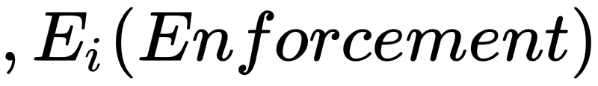
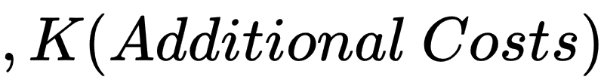
Elements of model

Slide 5
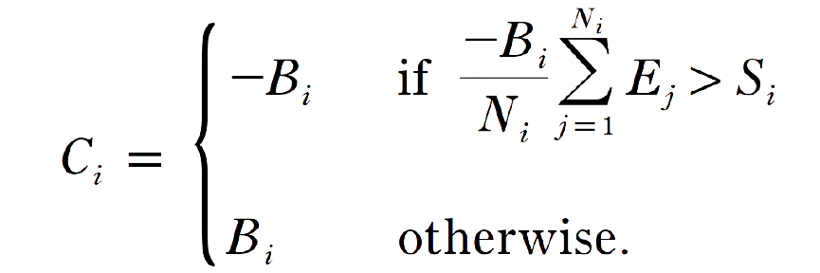
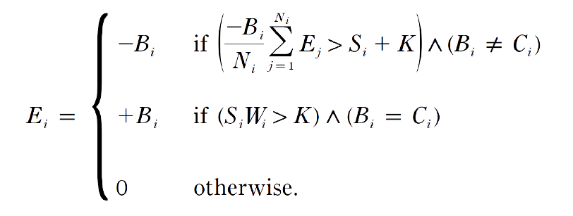
Definition
: 1 (Believe), (Disbelieve)
:
:
Notes:
B_i (Belief) ,C_i (Compliance), E_i(Enforcement),\space,K(additional costs)

Slide 6
[True/False] [Believer/Disbeliever]
 | Bi=1 | Bi=-1
Ci=1 | True believer | False disbeliever
Ci=-1 | False believers (does not exist in most scenario) | True disbeliever

Slide 7
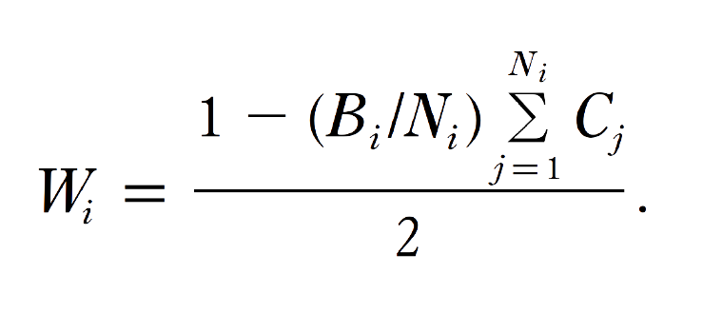
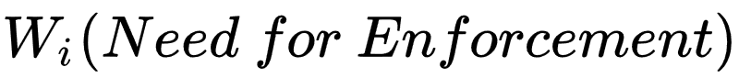
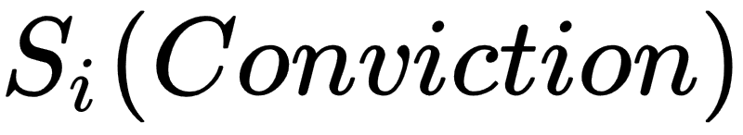
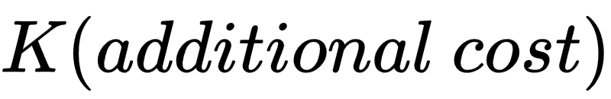
CONTENTS OF THIS TEMPLATE
:
: 1 for true believer (Bi=Ci=1), uniformly distributed in the range 0<Si≤.38 for disbelievers
: fixed at .125

Slide 8
Initial Setting
一開始每個人的Ei都是0
每個agent有8個鄰居，共有1000個agent
True Believer (Bi=Ci=1)與Disbeliever(Bi=-1)的比例為1比100
若要不信者comply，Si最小者至少需要N(Ei=1)-N(Ei=-1)>0 數量的鄰居，Si最大者至少需要N(Ei=1)-N(Ei=-1)>4 數量的鄰居

Slide 9
研究方法與重製的範圍
Experiment 1- Effect of Embeddedness
Random-Embedded, Cluster-Embedded, and Global
Experiment 2- Effect of Number and Clustering of True Believer
Experiment 3- Effect of Network Topology
von Neumann, Moore, Voronoi, Random rewiring
No Additional Tests

Slide 10
操作程序與重製的解讀
(概念操作化)
keyword | Centola et al. | Our Interpretation
embedded | “...embedded in a network that restricts interaction to small but overlapping neighbors” | problem → not a formal definition; no specification on structure of neighborhood (how does “overlapping” work? how small is “small”?) our guess → embedded refers to grid-like structure (patches in netlogo)
cluster | “when agents are clustered by beliefs...a skeptic exposed to a true believer can now expect to have other true believers in its neighborhood” | problem → no specification on what determines a cluster, how a cluster is generated in simulation our guess → true believers are grouped together, forming “circles” with a radius of 2~3 agents

Slide 11
操作程序與重製的解讀
(初始設定)
Topic | Quotes from Centola et al. | Our Interpretation
network | We explore network topologies using a two-dimensional cellular automata consisting of 1,000 agents located on a 40 x 25 torus, with every cell occupied by one agent. | use 40 * 25 plane on netlogo
replications | averaged over 100 replications at each parameter | 100 replications for: each # of clusters (1 2 3 4 … 99) (cluster-embedded); true believer (10 20 30 … 990) (random-embedded)
value of K | ...value of K, which we fixed at .125 | K=.125
convictions for disbelievers | for disbelievers, convictions were uniformly distributed in the range of 0 <Si<=.38 | operated using random-float in netlogo
default comply & enforce | A conservative assumption in a test of false enforcement is that agents initially conform to their private convictions and no one enforces anything. | initial Ci = Bi, Ei = 0

Slide 12
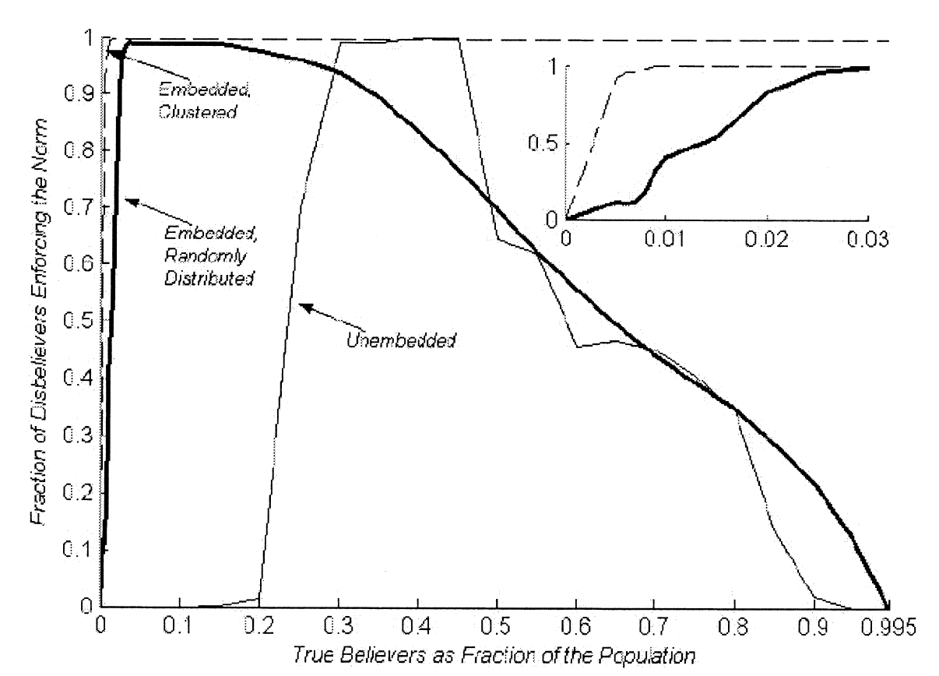
Centola et al. 2005 Experiment Results for Experiment 1 and 2

Slide 13
Netlogo介面解說
Color-Coding最重要的現象
Red: True Believer
Blue: Non-complying Disbeliever
Orange: Complying and Norm Enforcing
Disbeliever
Yellow: Complying but not Enforcing Disbeliever
其他可能：
non-enforcing true believers (when surrounded by compliers)
deviance-enforcing disbelievers (exists but is unimportant)

Slide 14
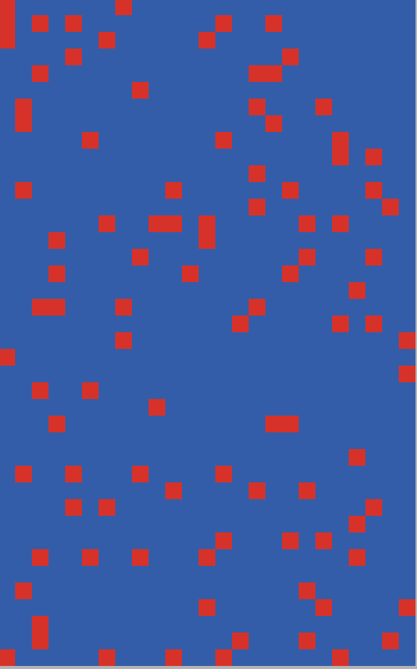
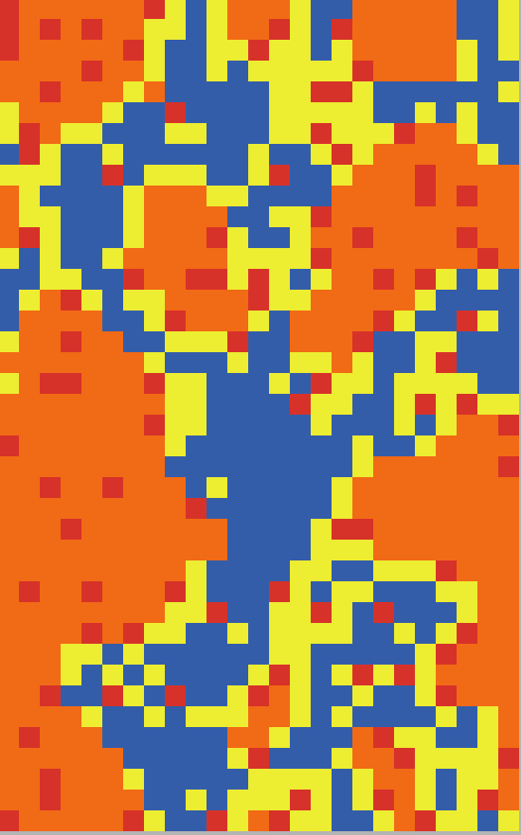
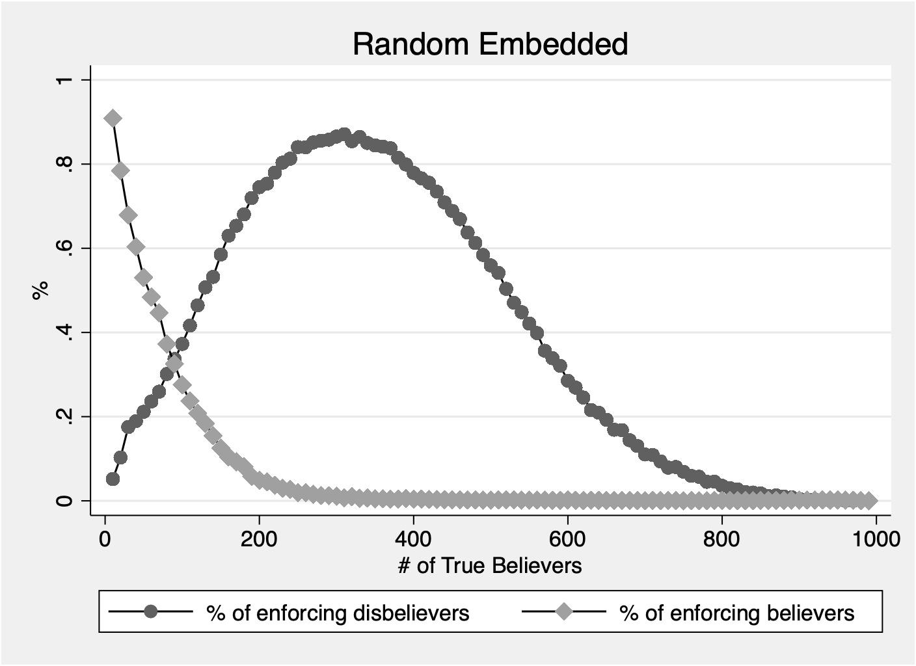
重製結果: Random Embedded
Example of random-embedded true believer
N=100
Simulation Result for left example

Slide 15

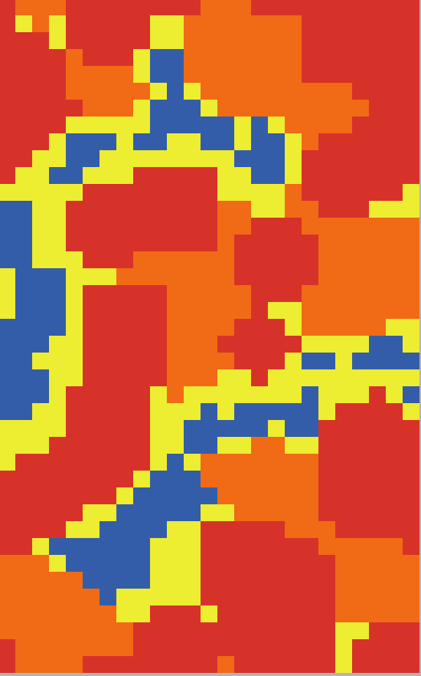
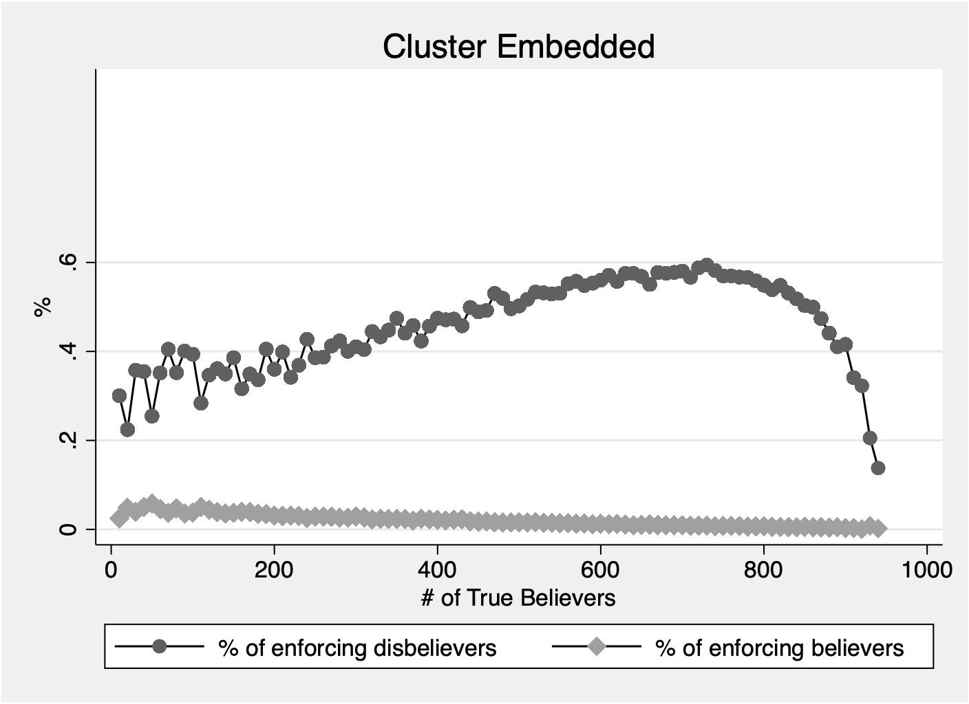
重置結果: Cluster Embedded
Example of cluster-embedded true believer
Cluster=30
Radius=2+(0.1~1)
True Believer=448
Simulation Result for left example

Slide 16
未重現Main Finding
For random embedded, the peak of enforcing disbeliever is at 30%, not 5% of true believer population. This cannot be considered a “highly unpopular norm”
For cluster embedded, the model did much worse than random embedded, both in peak spread and required % of true believers.

Slide 17
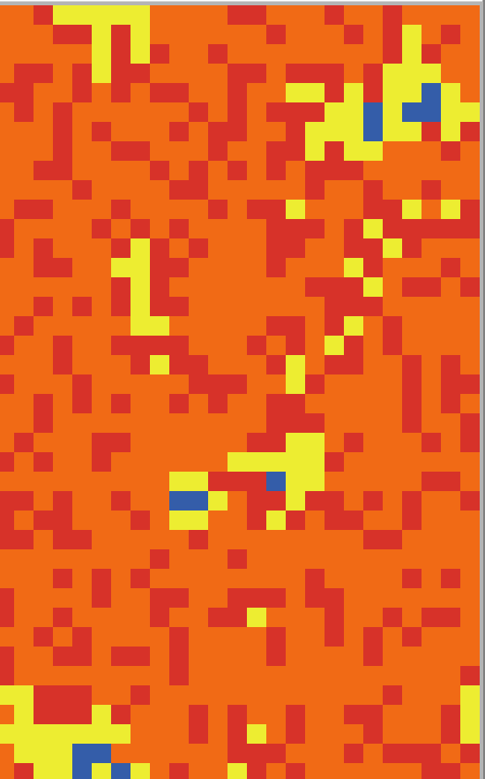
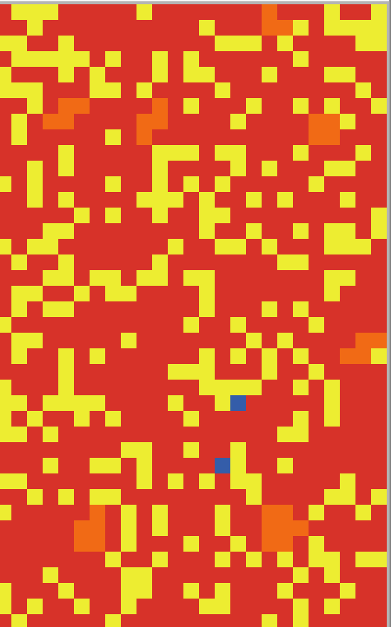
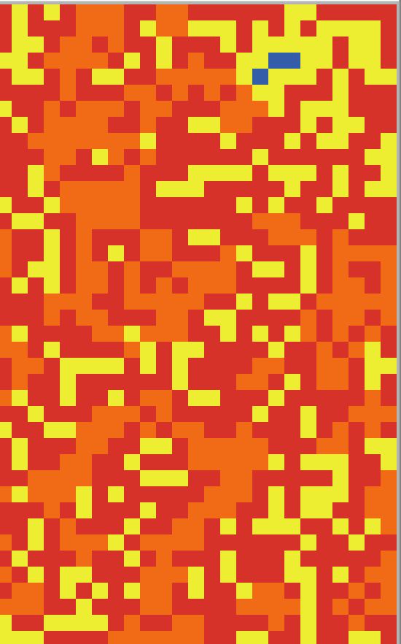
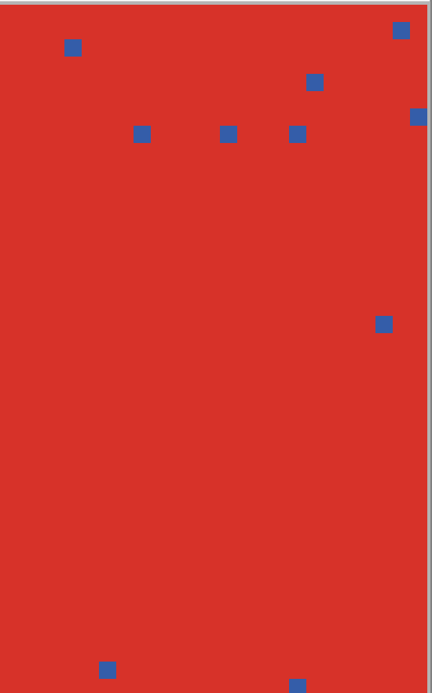
True Believer
300
True Believer
500
True Believer
700
True Believer
990

Slide 18
有重現部分的interactional dynamic
“However, as we increase the # of true believers further, their enforcement effectiveness begins to diminsh”
our random model # ~ 500
“when there is an overwhelming majority of true believers…...the tiny minority of disbelievers can enjoy an atmosphere of tolerance”
our random model: # of true believers ~ 950

Slide 19
結語
Problems with replication:
Information about computational procedure isn’t well organized.
Lack of clear operational definition “embedded” and “cluster” make the term open to interpretation and the findings hard to replicate.
Parts that were clearly defined, namely, the calculation for Bi, Ci, Ei, Wi, Si, K made the basic interactional dynamic reproducible

Slide 20
02
Bruch and Mare (2016)
You can enter here the subtitle if you need it

Slide 21
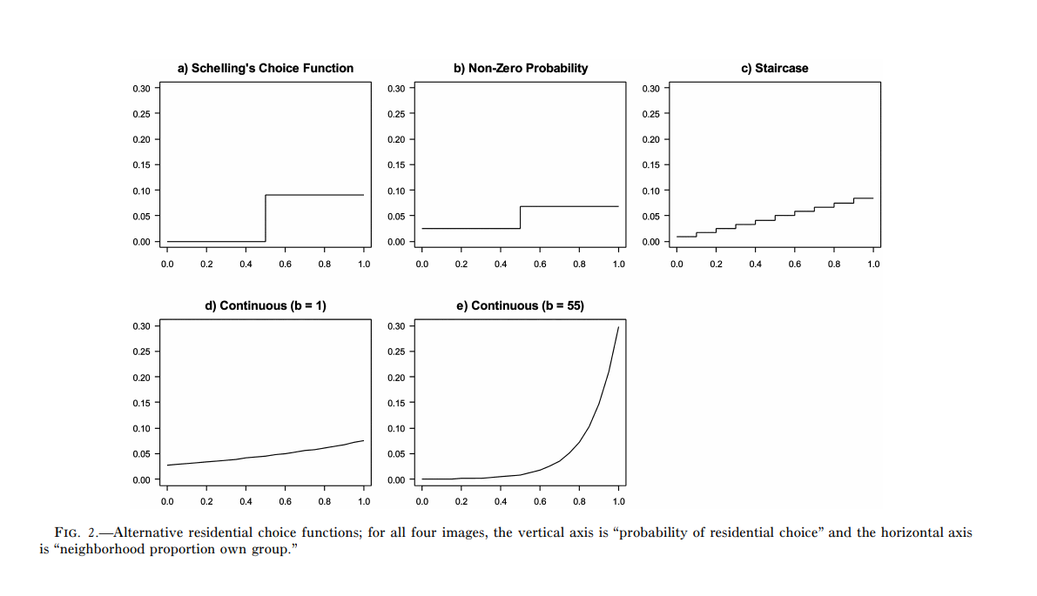
Preference Function

Slide 22
Our guess (which does not make sense to us)
根據作者對preference function的設定，其實就是逼每個agent一直搬家。
“ Using one of the preference functions described above, the selected agent calculates transition probabilities for its current neighborhood and the neighborhoods surrounding all available vacancies.”
“Based on these probabilities, the agent moves into another neighborhood in the city or remains in its current residence.”

Slide 23
CONTENTS OF THIS TEMPLATE
(1) 自己家只是搬家的目的地之一，把待在自己家的機會成本從schelling’s model中移除了
(2)分類越細，可移動的標的越多
(1)+(2) → less segregation is inevitable by design

Slide 24
CONTENTS OF THIS TEMPLATE

Slide 25
CONTENTS OF THIS TEMPLATE

Slide 26
CONTENTS OF THIS TEMPLATE

